Slide 1
ANLY 5332
Department of Information Systems and Analytics
McCoy College of Business Administration
Texas State University
Integer Programming

Slide 2
Outline
Integer/Binary Programming (Chapter 7.1)
Conditional Constraints Modeling (Chapter 7.2)
Mixed-Integer Programming (Chapter 7.5)
Solution Concepts
Extra Examples:
  Wyndor Problem with Setup Costs
  Caliente City Problem
  Southwestern Airways Problem
  Lipdon Tea Production
Self Study
  Distribution Network Design (not in the textbook)
  Integrated Facility Location-Transportation

Slide 3
Outline
Integer/Binary Programming (Chapter 7.1)
Conditional Constraints Modeling (Chapter 7.2)
Mixed-Integer Programming (Chapter 7.5)
Solution Concepts
Extra Examples:
  Wyndor Problem with Setup Costs
  Caliente City Problem
  Southwestern Airways Problem
  Lipdon Tea Production
Self Study
  Distribution Network Design (not in the textbook)
  Integrated Facility Location-Transportation

Slide 4
Integer/Binary Programming
In most of the linear programming and network optimization problems discussed so far, it is assumed that
  The decision variables are continuous, i.e., they can take fractional values
In many practical cases, the decision variables are not continuous
  They might be restricted to be integers or binary

Slide 5
Integer/Binary Programming
When the decisions variables are integer, we have integer programming problem
  Pure integer programming (IP)
    Binary integer programming (BIP)
  Mixed integer programming (MIP)
    Mixed binary integer programming (MBIP)
can be linear or non-linear
Models | Types of Decision Variables
Pure Integer (IP) | All are integers
Binary (BIP) | All are either 0 or 1
Mixed Integer (MIP) | Some, but not all, are integers
Mixed Binary (MBIP) | Some, but not all, are binaries

Slide 6
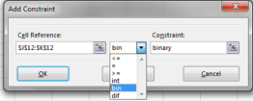
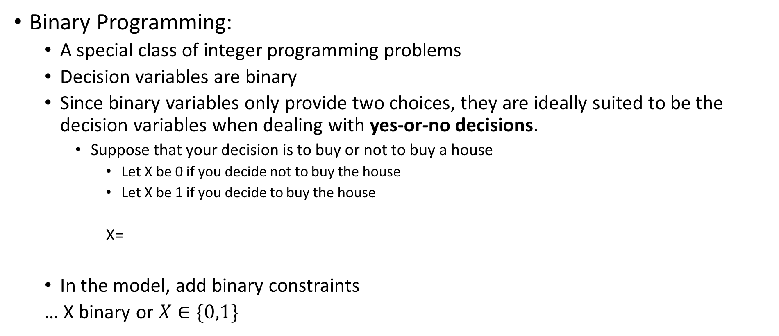
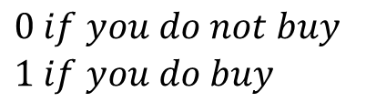
Integer/Binary Programming
Binary Programming:
  A special class of integer programming problems
  Decision variables are binary
  Since binary variables only provide two choices, they are ideally suited to be the decision variables when dealing with yes-or-no decisions.
    Suppose that your decision is to buy or not to buy a house
      Let X be 0 if you decide not to buy the house
      Let X be 1 if you decide to buy the house
      X=
  In the model, add binary constraints
  … X binary or $X∈\{0,1\}$
$$\begin{matrix}0 if you do not buy \\ 1 if you do buy \end{matrix}$$
Pick the decision variables that should be binary
Pick ‘bin’ and the constraint will be added

Slide 7
Integer/Binary Programming
Binary Programming applications:
    Investment Analysis: Should we make a certain fixed investment?
    Site Selection: Should a certain site be selected for the location of a new facility?
    Designing a Production and Distribution Network
      Should a certain plant remain open? Should a certain site be selected for a new plant? Should a distribution center remain open? Should a certain site be selected for a new distribution center? Should a certain distribution center be assigned to serve a certain market area?
    Dispatching Shipments
      Should a certain route be selected for a truck? Should a certain size truck be used? Should a certain time period for departure be used?
    Scheduling Interrelated Activities: Should a certain activity begin in a certain time period?
    Scheduling Asset Divestitures: Should a certain asset be sold in a certain time period?
    Airline Applications:
      Should a certain type of airplane be assigned to a certain flight leg? Should a certain sequence of flight legs be assigned to a crew?

Slide 8
Integer/Binary Programming
Case: California Manufacturing Co. Problem (Chapter 6.1)
  The California Manufacturing Company is a diversified company with several factories and warehouses throughout California, but none yet in Los Angeles or San Francisco.
  A basic issue is whether to build a new factory in Los Angeles or San Francisco, or perhaps even both. Management is also considering building at most one new warehouse, but will restrict the choice to a city where a new factory is being built.
  Question: Should the California Manufacturing Company expand with factories and/or warehouses in Los Angeles and/or San Francisco?
STEP 0:
 |  | Net Present Value (Millions) | Capital Required (Millions)
Build a factory in Los Angeles? |  | $8 | $6
Build a factory in San Francisco? |  | 5 | 3
Build a warehouse in Los Angeles? |  | 6 | 5
Build a warehouse in San Francisco? |  | 4 | 2
 | Capital Available: $10 million

Slide 9
Integer/Binary Programming
Case: California Manufacturing Co. Problem (Chapter 6.1)
STEP 1: Decision variables
  x₁ = 1 if build a factory in L.A.; 0 otherwise
  x₂ = 1 if build a factory in S.F.; 0 otherwise
  x₃ = 1 if build a warehouse in L.A.; 0 otherwise
  x₄ = 1 if build a warehouse in S.F.; 0 otherwise
When defining binary variables, make sure to explain what 0 means and what 1 means for the variable!
Decision Number | Decision Variable | Possible Value | Interpretation of a Value of 1 | Interpretation of a Value of 0
1 | x₁ | 0 or 1 | Build a factory in Los Angeles | Do not build this factory
2 | x₂ | 0 or 1 | Build a factory in San Francisco | Do not build this factory
3 | x₃ | 0 or 1 | Build a warehouse in Los Angeles | Do not build this warehouse
4 | x₄ | 0 or 1 | Build a warehouse in San Francisco | Do not build this warehouse

Slide 10
Integer/Binary Programming
Case: California Manufacturing Co. Problem (Chapter 6.1)
STEP 2: Objective and objective function
  Maximize NPV = 8x₁ + 5x₂ + 6x₃ + 4x₄ ($millions)
STEP 3: Constraints
  Capital available
  6x₁ + 3x₂ + 5x₃ + 2x₄ ≤ 10 ($millions)
  Management is also considering building at most one new warehouse,
  x₃ + x₄ ≤ 1
  but will restrict the choice to a city where a new factory is being built
  x₃ ≤ x₁
  x₄ ≤ x₂
If x₁=0, then x₃=0
If x₁=1, then x₃=1 or x₃=0
If x₂=0, then x₄=0
If x₂=1, then x₄=1 or x₄=0

Slide 11
Integer/Binary Programming
Case: California Manufacturing Co. Problem (Chapter 6.1)
Combining everything (not forgetting binary definition constraints), we have:
  Maximize 8x₁ + 5x₂ + 6x₃ + 4x₄
  Subject to 6x₁ + 3x₂ + 5x₃ + 2x₄ ≤ 10
  x₃ + x₄ ≤ 1
  x₃ ≤ x₁
  x₄ ≤ x₂
  x₁, x₂, x₃, x₄ are binary variables
  x₁∈{0,1}, x₂∈{0,1}, x₃∈{0,1}, x₄∈{0,1}

Slide 12
Integer/Binary Programming
Case: California Manufacturing Co. Problem (Chapter 6.1)
Spreadsheet model and the solution with Excel Solver

Slide 13
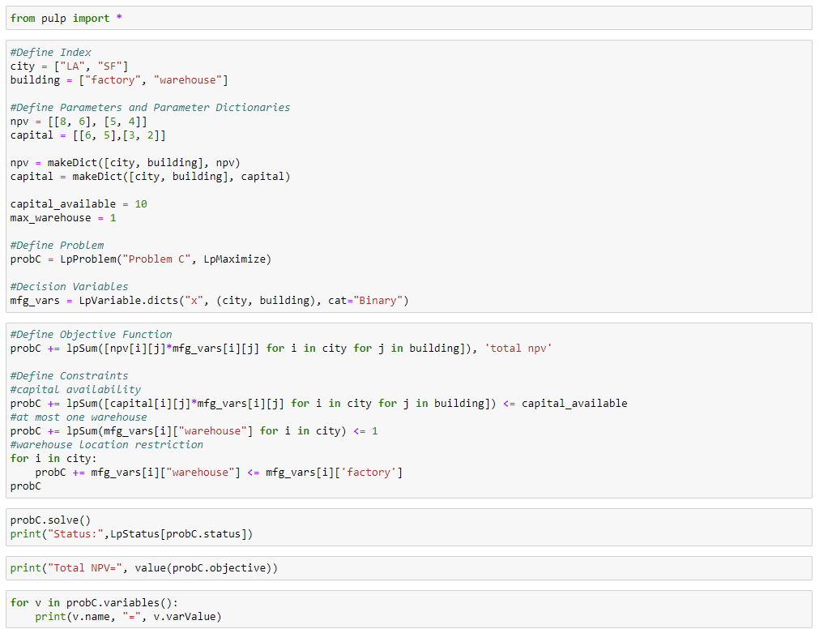
Integer/Binary Programming
Case: California Manufacturing Co. Problem (Chapter 6.1)
PuLP LP Setup

Slide 14
Outline
Integer/Binary Programming (Chapter 7.1)
Conditional Constraints Modeling (Chapter 7.2)
Mixed-Integer Programming (Chapter 7.5)
Solution Concepts
Extra Examples:
  Wyndor Problem with Setup Costs
  Caliente City Problem
  Southwestern Airways Problem
  Lipdon Tea Production
Self Study
  Distribution Network Design (not in the textbook)
  Integrated Facility Location-Transportation

Slide 15
Conditional Constraints Modeling
There might be conditional restrictions in the problem
  Constraints need to be added for such restrictions
Case: Project Selection at Tazer Corp. (Chapter 7.2)
  Tazer Corporation is searching for a new breakthrough drug. Five potential research and development projects:
    Project Up: Develop a more effect antidepressant that doesn’t cause mood swings
    Project Stable: Develop a drug that addresses manic depression
    Project Choice: Develop a less intrusive birth control method for women
    Project Hope: Develop a vaccine to prevent HIV infection
    Project Release: Develop a more effective drug to lower blood pressure
  $1.2 billion available for investment
  Question: Which projects should be selected to research and develop?

Slide 16
Conditional Constraints Modeling
Case: Project Selection at Tazer Corp. (Chapter 7.2)
STEP 0:
STEP 1: Decision variables
  Let x_{i} = 1 if approve project i; 0 otherwise (for i = 1, 2, 3, 4, and 5)
 | 1 - Up | 2 - Stable | 3 - Choice | 4 - Hope | 5- Release
R&D ($million) | 400 | 300 | 600 | 500 | 200
Success Rate | 50% | 35% | 35% | 20% | 45%
Revenue if Successful ($million) | 1,400 | 1,200 | 2,200 | 3,000 | 600
Expected Profit ($million) | 300 | 120 | 170 | 100 | 70
Expected Profit = Success Rate X Revenue if successful – R&D Cost

Slide 17
Conditional Constraints Modeling
Case: Project Selection at Tazer Corp. (Chapter 7.2)
STEP 2: Objective and objective function
  Maximize P = 300x₁ + 120x₂ + 170x₃ + 100x₄ + 70x₅
STEP 3: Constraints
  400x₁ + 300x₂ + 600x₃ + 500x₄ + 200x₅ ≤ 1,200
Combining everything (not forgetting binary definition constraints), we have:
Maximize P = 300x₁ + 120x₂ + 170x₃ + 100x₄ + 70x₅
Subject to 400x₁ + 300x₂ + 600x₃ + 500x₄ + 200x₅ ≤ 1,200
x_{i} are binary (for i = 1, 2, 3, 4, and 5).

Slide 18
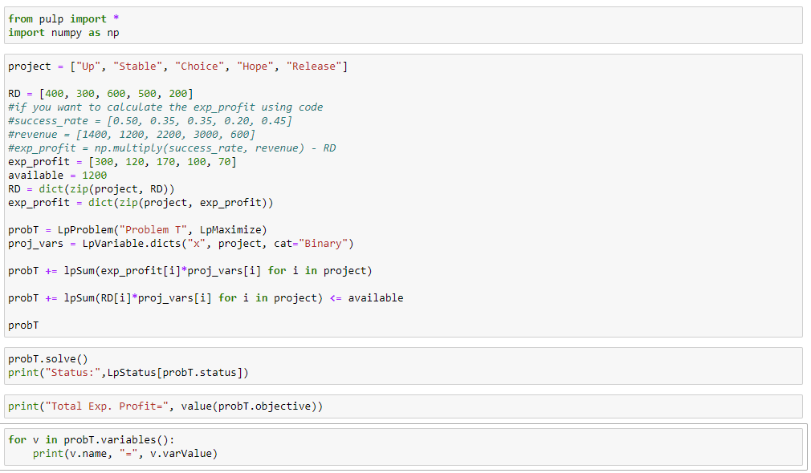
Conditional Constraints Modeling
Case: Project Selection at Tazer Corp. (Chapter 7.2)

Slide 19
Conditional Constraints Modeling
Case: Project Selection at Tazer Corp. (not in the textbook)
Additional constraints (independent of each other):
  At least 2 projects should be selected
    That is, total number of projects selected should be at least 2
    x₁ + x₂ + x₃ + x₄ + x₅ >= 2
  At most 3 projects can be selected
    That is, total number of projects selected cannot exceed 3
    x₁ + x₂ + x₃ + x₄ + x₅ <= 3
  If project 1 is selected, project 2 cannot be selected
    That is: if x₁ =1, then x₂ = 0
    → That is: if x₁ =1, then x₂ <= 0
?? Should be 0 when x1=1
x₂ <=
?? In terms of x₁
Mutually exclusive alternatives
?? Should make the whole constraint redundant when x1=0
x₂ <=1- x₁ → x₁ + x₂ <=1

Slide 20
Conditional Constraints Modeling
Case: Project Selection at Tazer Corp. (not in the textbook)
Additional constraints (independent of each other):
  If project 3 is selected, project 5 has to be selected as well
    That is: if x₃ =1, then x₅ = 1
  If project 2 is selected, at least 2 other projects should be selected
    That is: if x₂ =1, then x₁ + x₃ + x₄ + x₅ >= 2
→ That is: if x₃ =1, then x₅ >= 1
?? Should be 1 when x3=1
x₅ >=
?? In terms of x₃
x₅ >=x₃ → x₅ – x₃ >=0
?? Should make the whole constraint redundant when x3=0
?? Should be 2 when x2=1
x₁ + x₃ + x₄ + x₅ >=
?? In terms of x₂
?? Should make the whole constraint redundant when x2=0
x₁ + x₃ + x₄ + x₅ >=2x₂

Slide 21
Conditional Constraints Modeling
Case: Project Selection at Tazer Corp. (not in the textbook)
Additional constraints (independent of each other):
  If project 3 is selected, at most 2 other projects can be selected
    That is: if x₃ =1, then x₁ + x₂ + x₄ + x₅ <= 2
  Project 4 cannot be the only project selected
    That is: if project 4 is selected, at least one other project should be selected
    That is: if x₄ =1, then x₁ + x₂ + x₃ + x₅ >= 1
?? Should be 2 when x3=1
x₁ + x₂ + x₄ + x₅ <=
?? In terms of x₃
?? Should make the whole constraint redundant when x3=0
x₁ + x₂ + x₄ + x₅ <= 4-2x₃
?? Should be 1 when x4=1
x₁ + x₂ + x₃ + x₅ >=
?? In terms of x₄
?? Should make the whole constraint redundant when x4=0
x₁ + x₂ + x₃ + x₅ >=x₄

Slide 22
Conditional Constraints Modeling
Case: Project Selection at Tazer Corp. (not in the textbook)
Additional constraints (independent of each other):
  If both projects 2 and 3 are selected, project 4 has to be selected
    That is: if x₂ + x₃ =2, then x₄ >=1
  If both projects 4 and 5 are selected, project 1 cannot be selected
    That is: if x₄ + x₅ =2, then x₁ <= 0
?? Should be 1 when x₂ + x₃ =2
x₄ >=
?? In terms of x₂ + x₃
x₄ >= x₂ + x₃ -1
?? Should make the whole constraint redundant when x₂ + x₃ <=1
?? Should be 0 when x₄ + x₅ =2
x₁ <=
?? In terms of x₄ + x₅
?? Should make the whole constraint redundant when x₄ + x₅ <=1
x₁ <= 2-(x₄ + x₅)

Slide 23
Outline
Integer/Binary Programming (Chapter 7.1)
Conditional Constraints Modeling (Chapter 7.2)
Mixed-Integer Programming (Chapter 7.5)
Solution Concepts
Extra Examples:
  Wyndor Problem with Setup Costs
  Caliente City Problem
  Southwestern Airways Problem
  Lipdon Tea Production
Self Study
  Distribution Network Design (not in the textbook)
  Integrated Facility Location-Transportation

Slide 24
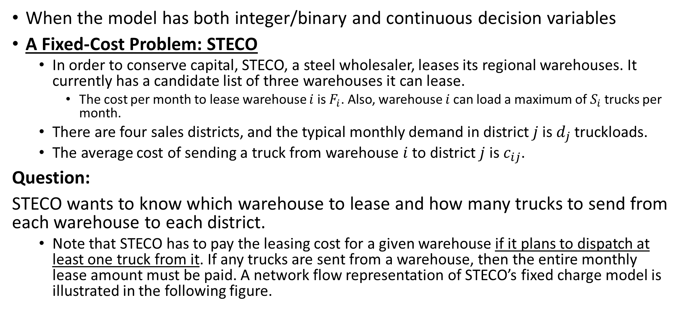
Mixed-Integer Programming
When the model has both integer/binary and continuous decision variables
A Fixed-Cost Problem: STECO
  In order to conserve capital, STECO, a steel wholesaler, leases its regional warehouses. It currently has a candidate list of three warehouses it can lease.
    The cost per month to lease warehouse $i$ is $F_{i}$. Also, warehouse $i$can load a maximum of$S_{i}$trucks per month.
  There are four sales districts, and the typical monthly demand in district $j$is $d_{j}$ truckloads.
  The average cost of sending a truck from warehouse $i$ to district $j$ is $c_{ij}$.
Question:
STECO wants to know which warehouse to lease and how many trucks to send from each warehouse to each district.
  Note that STECO has to pay the leasing cost for a given warehouse if it plans to dispatch at least one truck from it. If any trucks are sent from a warehouse, then the entire monthly lease amount must be paid. A network flow representation of STECO’s fixed charge model is illustrated in the following figure.

Slide 25
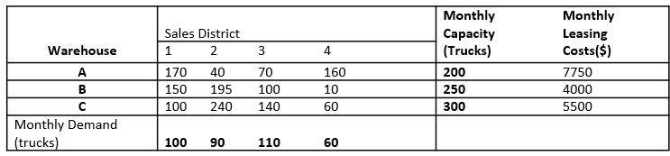
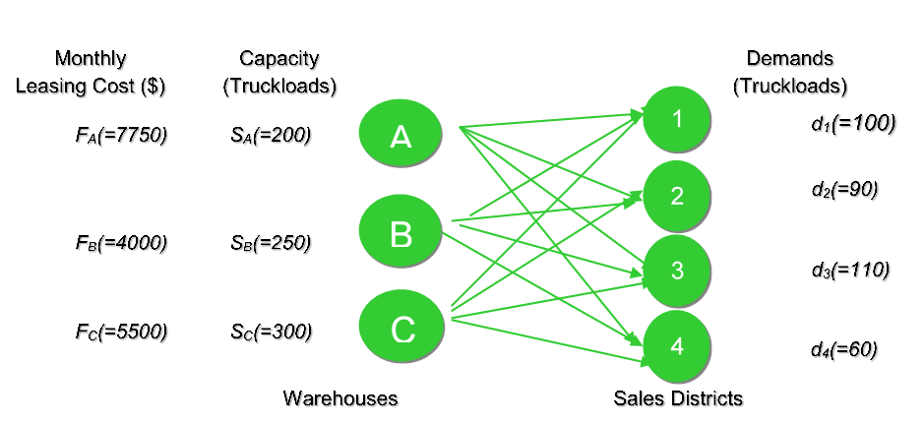
Mixed-Integer Programming
A Fixed-Cost Problem: STECO
  The data for this model are presented in the following table. For example, it costs $7,750 to lease warehouse A for a month and that up to 200 trucks can be loaded and dispatched from this warehouse. The shipping cost from warehouse A to District 1 is $170 per truckload. Also, the monthly demand in sales district 1 is 100 truckloads, the variable cost of sending a truck from B to 3 is $100.
STEP 0:

Slide 26
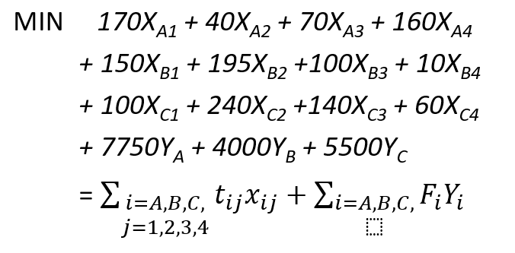

Mixed-Integer Programming
A Fixed-Cost Problem: STECO
STEP 1: Decision Variables
  $X_{ij}=$number of truckloads to ship from warehouse $i$ to sales district $j$, $i=A,B,C, j=1,2,3,4$.
  $Y_{i}=0$ or $1, i=A,B,C$ (1 if lease warehouse $i$; 0, otherwise)
STEP 2: Objective and Objective Functions

Slide 27
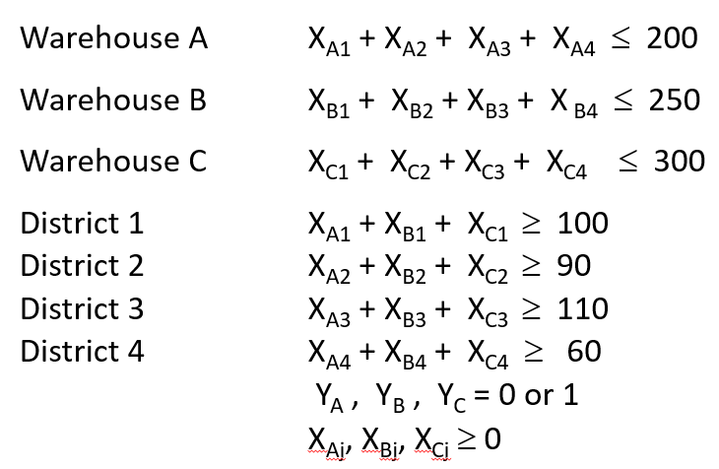
Mixed-Integer Programming
A Fixed-Cost Problem: STECO
STEP 3: Constraints

Slide 28
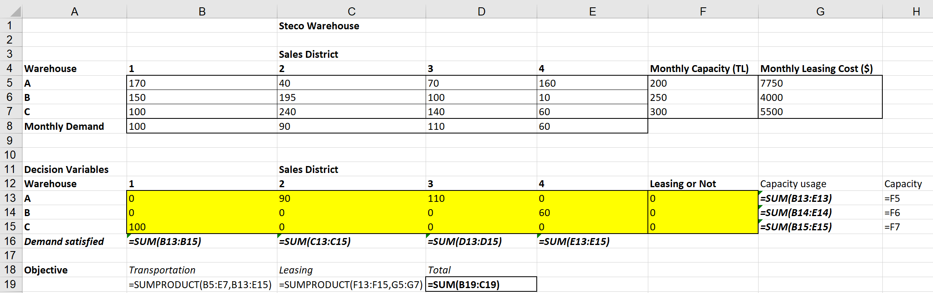
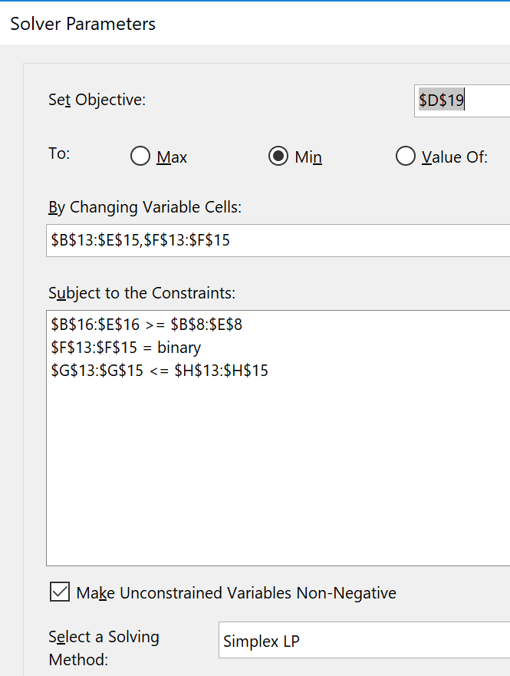
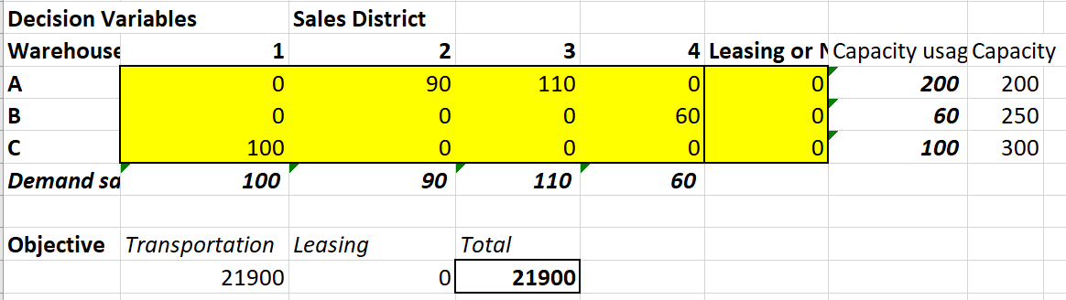
Mixed-Integer Programming
A Fixed-Cost Problem: STECO
What is wrong?

Slide 29
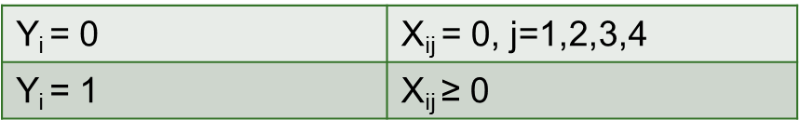
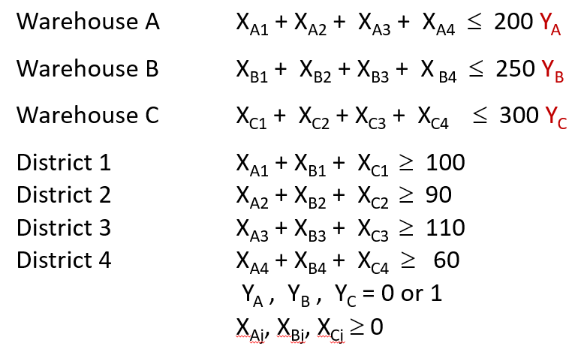
Mixed-Integer Programming
A Fixed-Cost Problem: STECO
STEP 3: Constraints (Correct Formulation)
X_{ij} and Y_{i} should satisfy the following relationship:

Slide 30
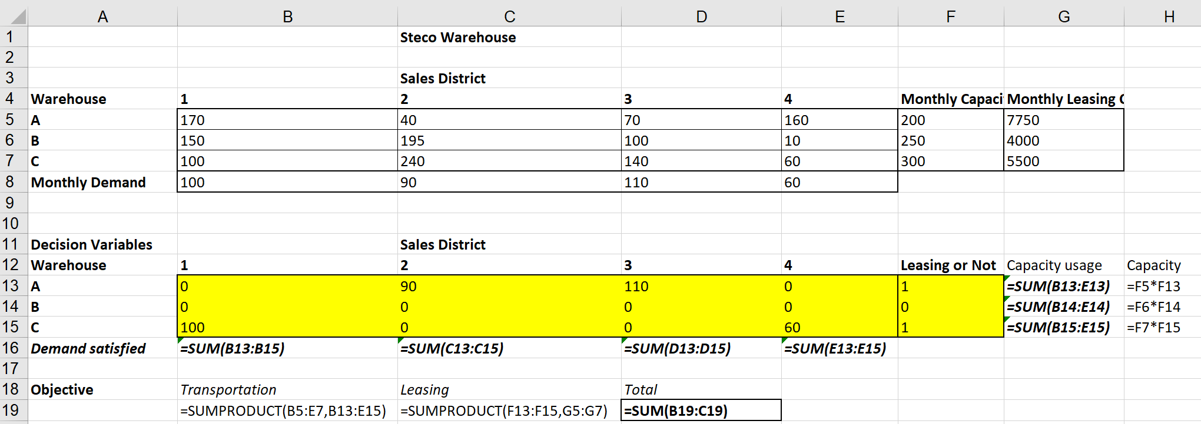
Mixed-Integer Programming
A Fixed-Cost Problem: STECO

Slide 31
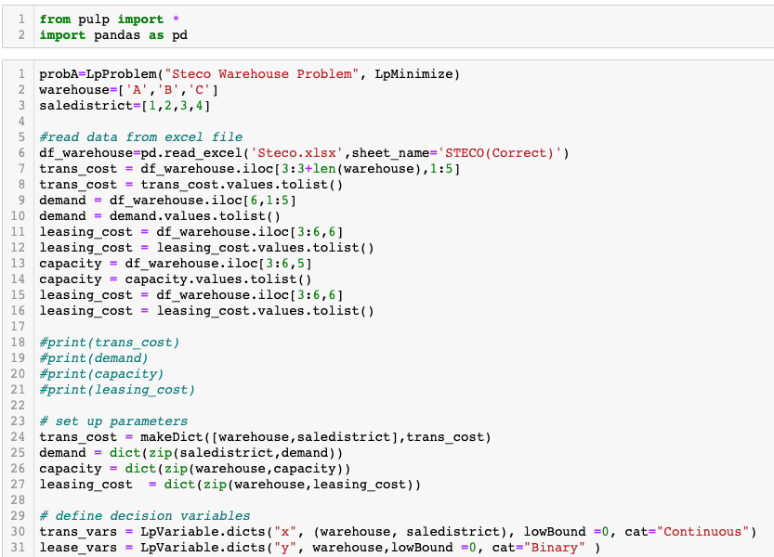
Mixed-Integer Programming
A Fixed-Cost Problem: STECO

Slide 32
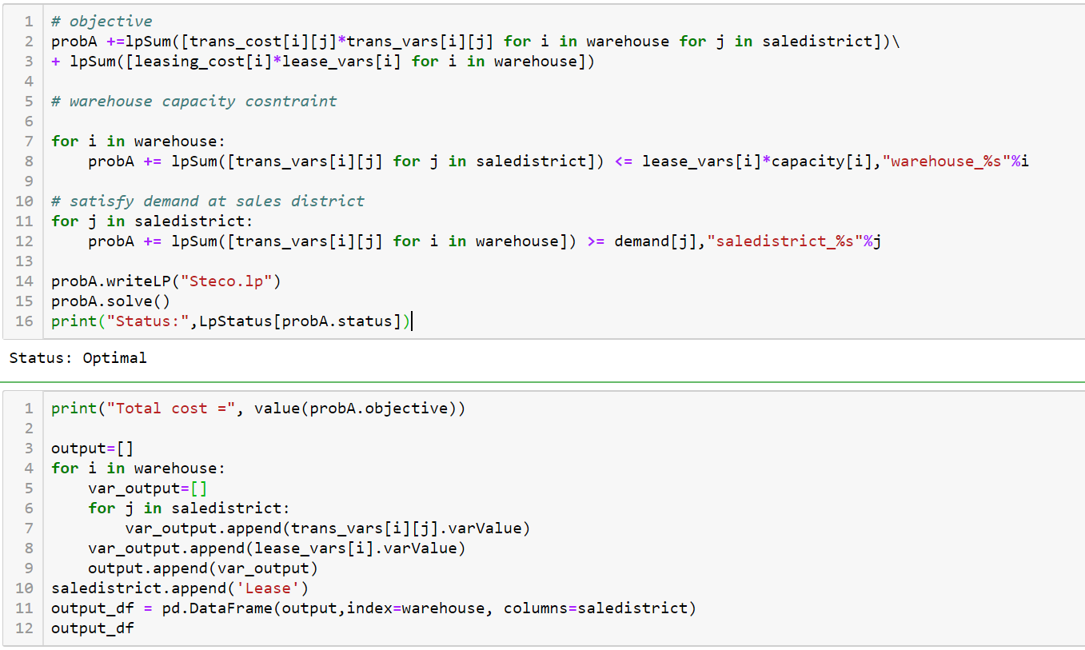
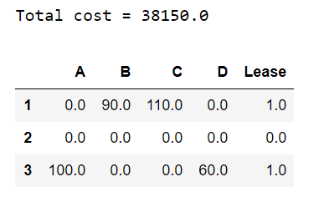
Mixed-Integer Programming
A Fixed-Cost Problem: STECO

Slide 33
Outline
Integer/Binary Programming (Chapter 7.1)
Conditional Constraints Modeling (Chapter 7.2)
Mixed-Integer Programming (Chapter 7.5)
Solution Concepts
Extra Examples
  Wyndor Problem with Setup Costs
  Caliente City Problem
  Southwestern Airways Problem
  Lipdon Tea Production
Self Study
  Distribution Network Design (not in the textbook)
  Integrated Facility Location-Transportation

Slide 34
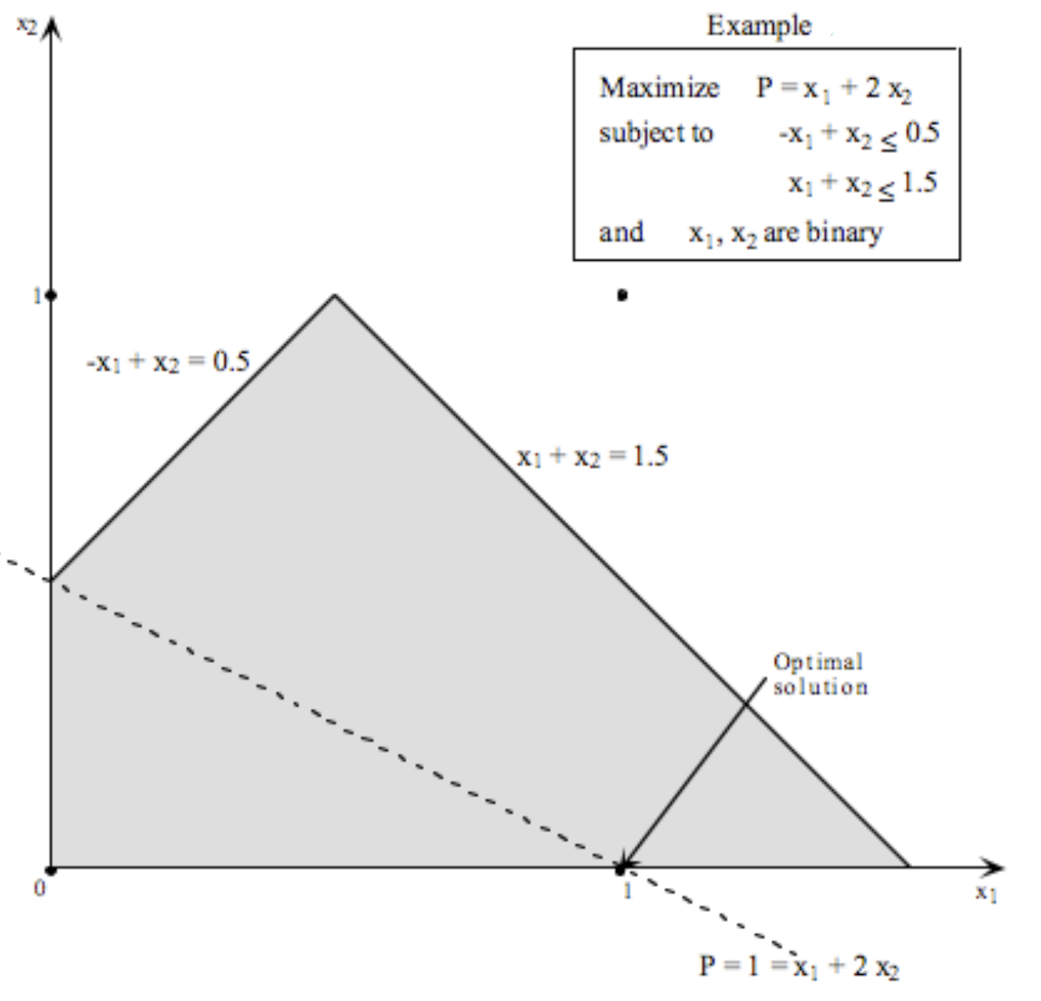
Solution Concepts
Integer programming problems are harder to solve compared to the Linear programming problems
  Basically, IPs do not have the corner solution property
  When we draw the constraint lines, the corner points can be non-integer
  See the example on right:
    The only feasible solutions are (0, 0) and (1, 0), where (1, 0) is the optimal solution
.

Slide 35
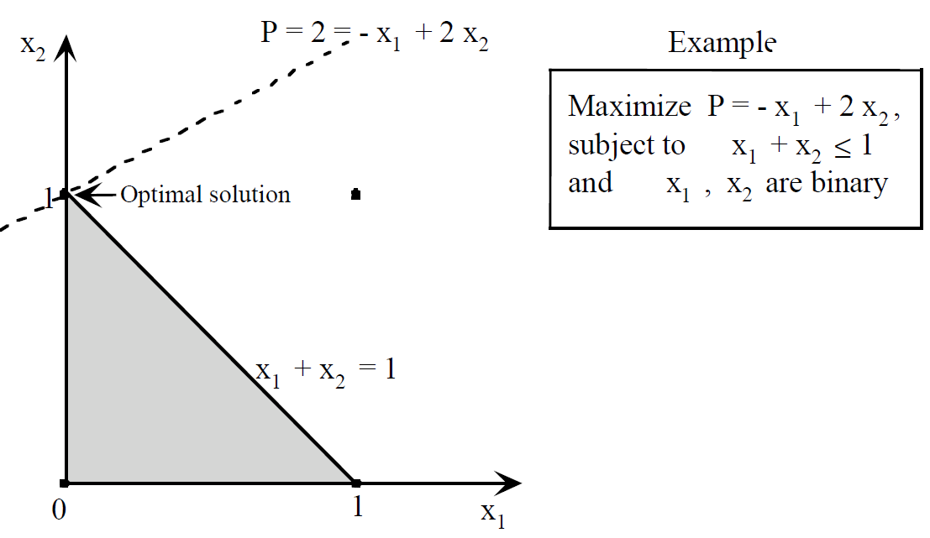
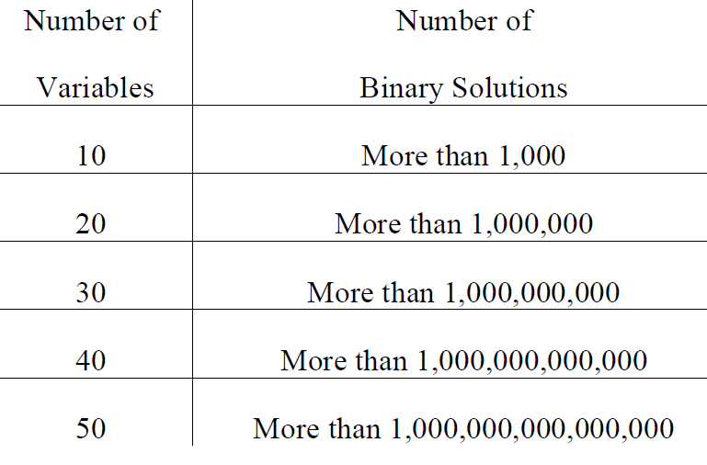
Solution Concepts
One approach can be exhaustive (total) enumeration
  Identify all of the solutions
  Calculate the objective function value for each feasible solution
  Pick the best feasible solution
Not practical!
  Illustration:
    The binary solutions for (x1, x2) are (0, 0), (1, 0), (0, 1), and (1, 1)
    (0, 0), (1, 0), and (0, 1) are the feasible solutions
    Objective function values for feasible solutions:
      For (0, 0), P = x1 + 2x2 = 0 + 0 = 0.
      For (1, 0), P = x1 + 2x2 = 1 + 0 = 1.
      For (0, 1), P = x1 + 2x2 = 0 + 2 = 2.
    Sol (0,1) is the optimum.

Slide 36
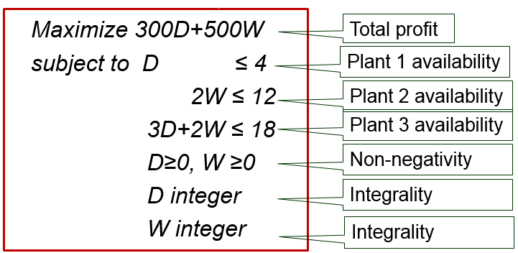
Solution Concepts
Recall the Wyndor Glass Co. Product-Mix Problem
  Now, suppose that production is not continuous
  Windows and doors will be produced just for one week
  Therefore, it is not practical to assume that D and W are continuous
    D and W should be integers
The updated models:

Slide 37
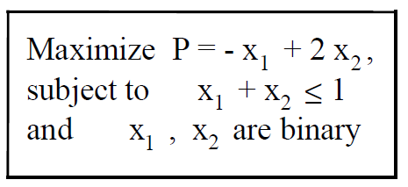
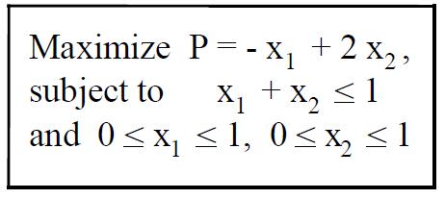
Solution Concepts
Linear Relaxation: The integer model without the integer constraints
  Maximize 300D+500W
  subject to D ≤ 4
  2W ≤ 12
  3D+2W ≤ 18
  D≥0, W ≥0
  D integer
  W integer
  Maximize 300D+500W
  subject to D ≤ 4
  2W ≤ 12
  3D+2W ≤ 18
  D≥0, W ≥0
Its linear relaxation
Integer programming model
Binary programming model
Its linear relaxation

Slide 38
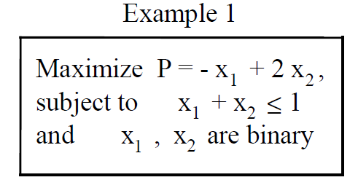
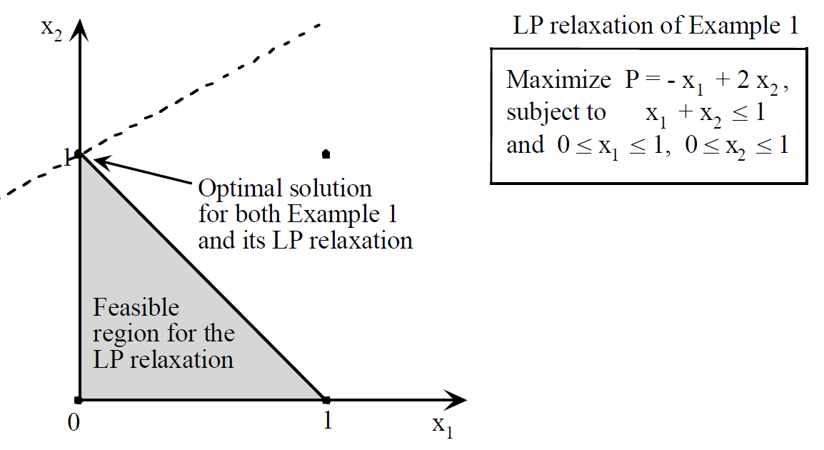
Solution Concepts
Linear Relaxation: Easy to solve!
  If the linear relaxation returns an integer solution, then we have the optimum solution to the integer model as well! ☺

Slide 39
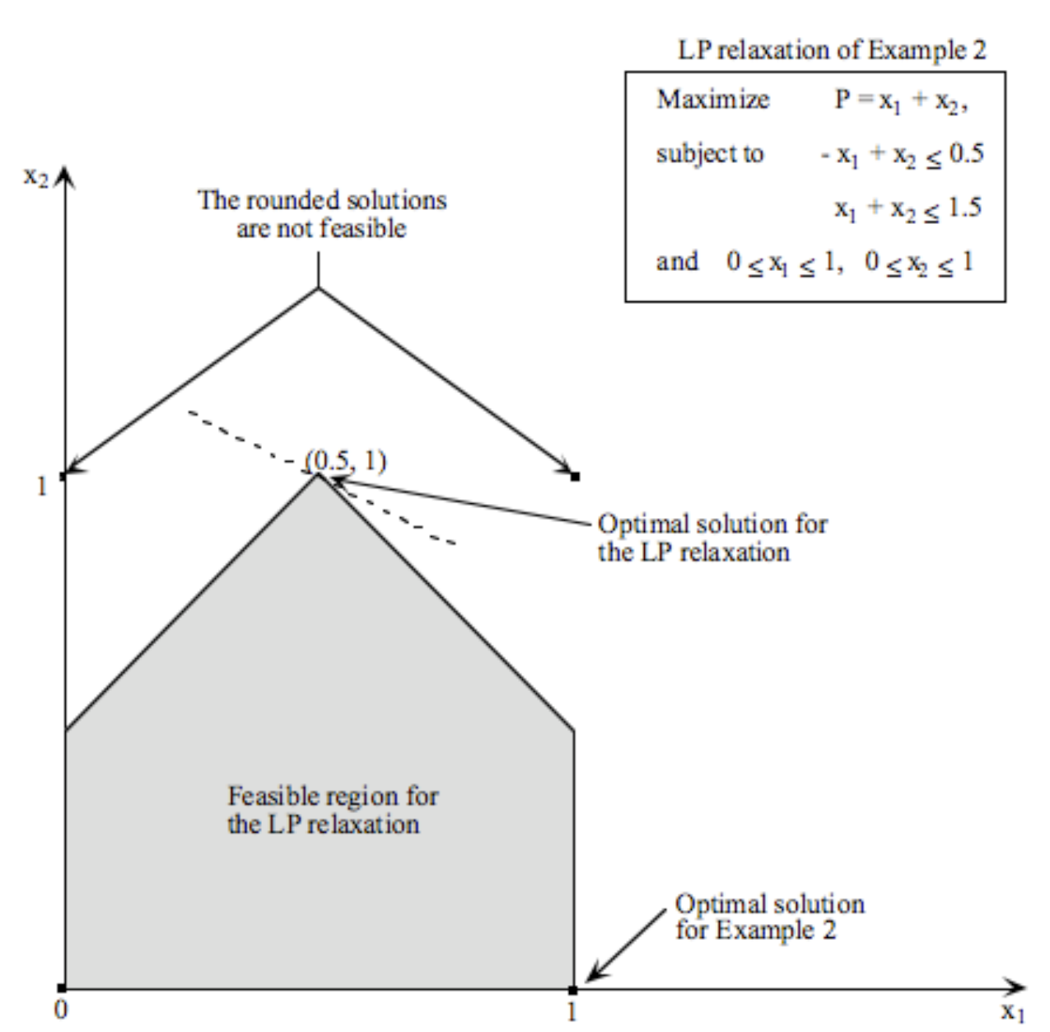
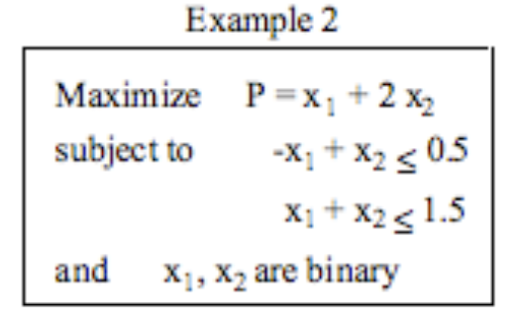
Solution Concepts
Linear Relaxation: Easy to solve!
  But the optimum solution of the linear relaxation is not necessarily going to be an integer ☹
  Then what? Round the optimum solution of the linear relaxation?

Slide 40
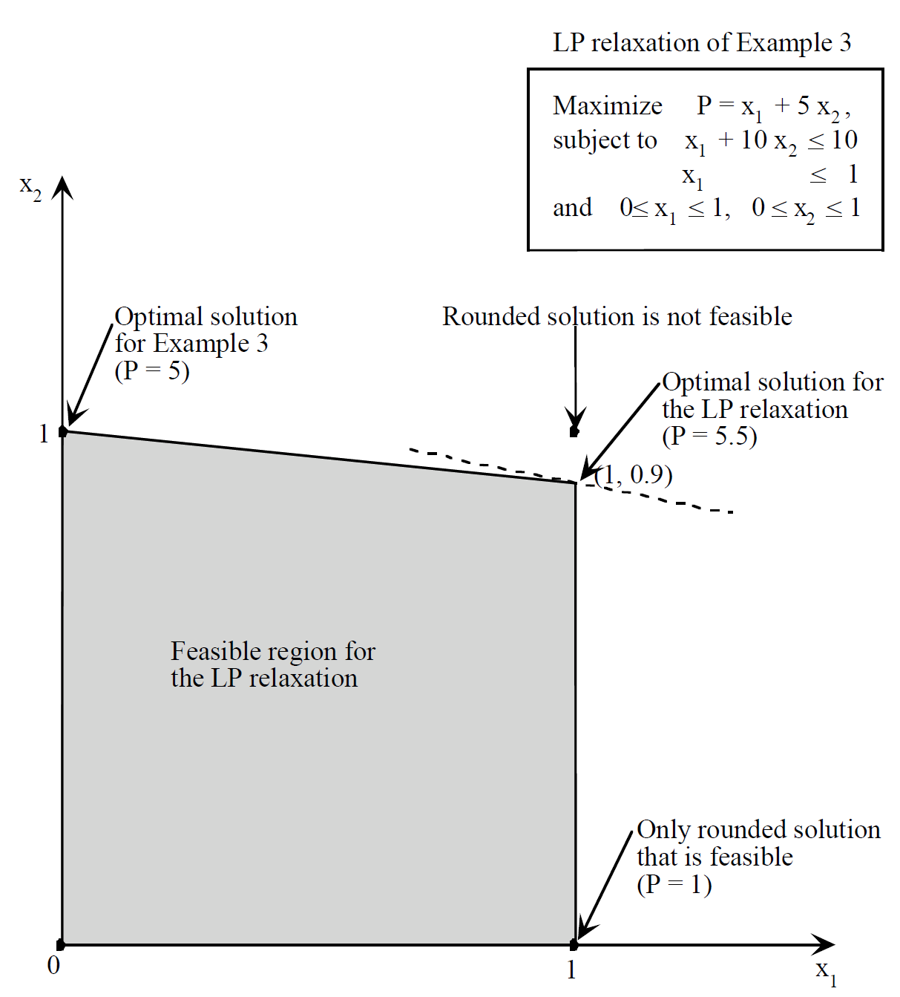
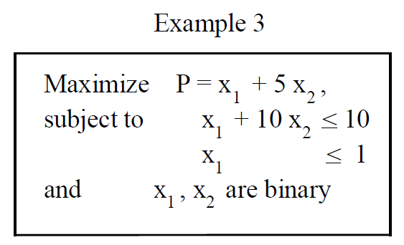
Solution Concepts
Linear Relaxation: Easy to solve!
  But the optimum solution of the linear relaxation is not necessarily going to be an integer ☹
  Then what? Round the optimum solution of the linear relaxation?

Slide 41
Solution Concepts
There are solution methods that utilize linear relaxation’s solution in a systematic way!
  The relations between integer programming model (IP) and its linear relaxation (LRP)
    If the objective is minimization
      The optimal objective function value of IP is greater than or equal to the optimal objective function value of LRP
    If the objective is maximization
      The optimal objective function value of IP is smaller than or equal to the optimal objective function value of LRP
  That is, the optimum solution of the linear relaxation model is better or the same compared to the optimum solution of the integer model

Slide 42
Branch and Bound
Any pure integer model has finite number of solutions
  But enumerating all of them computational hard
  There will be exponentially many solutions
The idea of the branch and bound method is to use linear relaxations!!
  Observation: If the optimal solution of the LRP of an IP is integer, then it is also optimal for the IP
    Because there cannot be a solution that will be better for the IP since LRP solution is better or the same!
  If the optimal solution of the LRP of an IP is not integer, that solution is not feasible to IP, hence, we can disregard that solution from LRP and solve LRP again!
    How to avoid that solution?
      Branching

Slide 43
Branch and Bound
Consider an IP with decision variables xi
Optimum solution to IP-0 is the best one of the optimum solutions to IP-1 and IP-2
  So, we will solve IP-1 and IP-2
Max cx
s.t. Ax<=b
x integer
Solve its LRP (LRP-0) and say xj=3.5 for variable j in the optimal solution of the LRP-0
IP-0
Max cx
s.t. Ax<=b
xj<=3
x integer
Max cx
s.t. Ax<=b
xj>=4
x integer
IP-1
IP-2

Slide 44
Branch and Bound
But IP-1 and IP-2 are also integer models!
  So, we will solve their linear relaxations as well
Max cx
s.t. Ax<=b
xj<=3
x integer
Max cx
s.t. Ax<=b
xj>=4
x integer
IP-2
IP-1
Solve its LRP (LRP-1) and suppose that the solution is integer!
So, we have the solution for IP-1
Suppose that the objective function value is 120
This is the best integer solution we have so far!
Solve its LRP (LRP-2) and suppose that the solution is not integer and say xk=1.333
Suppose that objective function value of the optimal LRP-2 solution is 115
We do not need to continue, because we cannot find an integer solution better than 115 and we already have an integer solution with 120!!
So, we do not branch

Slide 45
Branch and Bound
But IP-1 and IP-2 are also integer models!
  So, we will solve their linear relaxations as well
Max cx
s.t. Ax<=b
xj<=3
x integer
Max cx
s.t. Ax<=b
xj>=4
x integer
IP-2
IP-1
Solve its LRP (LRP-1) and suppose that the solution is integer!
So, we have the solution for IP-1
Suppose that the objective function value is 120
This is the best integer solution we have so far!
Solve its LRP (LRP-2) and suppose that the solution is not integer and say xk=1.333
Suppose that objective function value of the optimal LRP-2 solution is 127
We need to continue branching, because we can find an integer solution better than 120
So, we branch

Slide 46
Branch and Bound
Continue with solving IP-2
Max cx
s.t. Ax<=b
xj<=3
x integer
Solve its LRP (LRP-2) and suppose that the solution is not integer and say xk=1.333
Suppose that objective function value of the optimal LRP-2 solution is 127
We need to continue branching, because we can find an integer solution better than 120
So, we branch
IP-1
Max cx
s.t. Ax<=b
xj>=4
x integer
IP-2
Solve its LRP (LRP-1) and suppose that the solution is integer!
So, we have the solution for IP-1
Suppose that the objective function value is 120
This is the best integer solution we have so far!
Max cx
s.t. Ax<=b
xj>=4
xk<=1
x integer
Max cx
s.t. Ax<=b
xj>=4
xk>=2
x integer
IP-3
IP-4

Slide 47
Branch and Bound
Note that each time we branch, we create new sub-problems by adding constraints
  It is possible that the subproblem is infeasible, so we will not continue branching from it as the further subproblems it creates will also be infeasible
Max cx
s.t. Ax<=b
xj>=4
xk<=1
x integer
Max cx
s.t. Ax<=b
xj>=4
xk>=2
x integer
IP-4
IP-3
Solve its LRP (LRP-1) and suppose that the solution is integer!
So, we have the solution for IP-4
Suppose that the objective function value is 123
We need to compare this to the best integer solution we currently have, which has 120
If it is better, we update the best integer solution
Solve its LRP (LRP-3) is infeasible
So, we stop branching

Slide 48
Branch and Bound
The main idea is to solve the linear relaxations of the subproblems
  If there is no subproblem we do not need to solve the linear relaxation for, then the best integer solution we have is the optimum solution or problem
  We stop creating branching (i.e., we fathom) if
    A subproblem is infeasible
    A subproblem’s linear relaxation has integer solution
      In this case, we need to update the best integer solution
    A subproblem’s linear relaxation has an optimal objective function value that is worse than or equal to the current best integer solution’s objective function value

Slide 49
Heuristics
Heuristics are algorithms that are fast
  They are not guaranteed to give the optimum solution
  But they return good solutions
    It is always good to consider the underlying structures of the problem of interest and utilize those in developing heuristic methods
  There are many generic heuristic methods:
    Genetic algorithms, evolutionary methods
    Tabu search
    Ant colony optimization
    Particle swarm optimization

Slide 50
Outline
Integer/Binary Programming (Chapter 7.1)
Conditional Constraints Modeling (Chapter 7.2)
Mixed-Integer Programming (Chapter 7.5)
Solution Concepts
Extra Examples
  Wyndor Problem with Setup Costs
  Caliente City Problem
  Southwestern Airways Problem
  Lipdon Tea Production
Self Study
  Distribution Network Design (not in the textbook)
  Integrated Facility Location-Transportation

Slide 51
Mixed-Integer Programming
When the model has both integer/binary and continuous decision variables
  Need to be careful when associating integer/binary variables with continuous variables
  Big M constraints!
Case: Wyndor Problem with Setup Costs (Chapter 7.5)
  For each product, producing any units requires a substantial one-time setup cost for setting up the production facilities
    Setup cost is $700 for doors
    Setup cost is $1,300 for windows
  The production runs for these products will be ended after one week, so D and W in the original model now represent the total number of doors and windows produced, respectively, rather than production rates.

Slide 52
Mixed-Integer Programming
Case: Wyndor Problem with Setup Costs (Chapter 7.3)
STEP 0: Same data
 | Net Profit ($)
Number of Units Produced | Doors | Windows
0 | 0(300) – 0 = 0 | 0 (500) – 0 = 0
1 | 1(300) – 700 = –400 | 1(500) – 1,300 = –800
2 | 2(300) – 700 = –100 | 2(500) – 1,300 = –300
3 | 3(300) – 700 = 200 | 3(500) – 1,300 = 200
4 | 4(300) – 700 = 500 | 4(500) – 1,300 = 700
5 | Not feasible | 5(500) – 1,300 = 1,200
6 | Not feasible | 6(500) – 1,300 = 1,700

Slide 53
Mixed-Integer Programming
Case: Wyndor Problem with Setup Costs (Chapter 7.3)
STEP 1: Decision variables
  D = Number of doors to produce,
  W = Number of windows to produce,
  y₁ = 1 if perform setup to produce doors; 0 otherwise,
  y₂ = 1 if perform setup to produce windows; 0 otherwise
STEP 2: Objective and objective function
  Maximize P = 300D + 500W – 700y₁ – 1,300y₂

Slide 54
Mixed-Integer Programming
Case: Wyndor Problem with Setup Costs (Chapter 7.3)
STEP 3: Constraints
  Original Constraints:
    Plant 1: D ≤ 4
    Plant 2: 2W ≤ 12
    Plant 3: 3D + 2W ≤ 18
  No setup, no production!
  If setup, we can produce any amount (other constraints will restrict)
    If no setup for doors, doors cannot be produced;
    but if setup is paid, any number of doors can be produced.
      That is: if y₁ = 0, then D=0; but if y₁ = 1, then D<=M, where M is a large number
      Therefore, we have
      D ≤ My₁
    Same discussion for windows
      W ≤ My₂

Slide 55
Mixed-Integer Programming
Case: Wyndor Problem with Setup Costs (Chapter 7.3)
Combining everything (not forgetting binary definition and non-negativity constraints), we have:
Maximize P = 300D + 500W – 700y1 – 1,300y2
subject to D ≤ 4
2W ≤ 12
3D + 2W ≤ 18
D ≤ My1
W ≤ My2
D ≥ 0, W ≥ 0,
y1 and y2 are binary.
When trying to solve the model, we need to define values for M…
for each constraint, it might be a different number
For this problem, for instance, we can use M=99
M should be sufficiently large so that the constraint does not eliminate any possibilities

Slide 56
Mixed-Integer Programming
Case: Wyndor Problem with Setup Costs (Chapter 7.3)
Spreadsheet model:

Slide 57
Mixed-Integer Programming
Case: Wyndor Problem with Setup Costs (Chapter 7.3)
Additional constraint:
  If you produce doors, you have to produce at least 3 of them
  D>= 3? Would work?
    No, because D can be 0 too
  How about
    D>=3y₁
    D<=My₁
  Even if we did not have the setups, we would still need to define y₁ in this case!

Slide 58
Site Selection
Case: Caliente City Problem (Chapter 7.3):
  Case Description: Caliente City is growing rapidly and spreading well beyond its original borders
    They still have only one fire station, located in the congested center of town
    The result has been long delays in fire trucks reaching the outer part of the city
  Goal: Develop a plan for locating multiple fire stations throughout the city to minimize costs
  New Policy: Response Time ≤ 10 minutes

Slide 59
Site Selection
Case: Caliente City Problem (Chapter 7.3):
STEP 0:
STEP 1: Decision Variables
  Let x_{j} = 1 if tract j is selected to receive a fire station; 0 otherwise (j = 1, 2, … , 8)
 |  | Fire Station in Tract
 |  | 1 | 2 | 3 | 4 | 5 | 6 | 7 | 8
Response times (minutes) for a fire in tract | 1 | 2 | 8 | 18 | 9 | 23 | 22 | 16 | 28
 | 2 | 9 | 3 | 10 | 12 | 16 | 14 | 21 | 25
 | 3 | 17 | 8 | 4 | 20 | 21 | 8 | 22 | 17
 | 4 | 10 | 13 | 19 | 2 | 18 | 21 | 6 | 12
 | 5 | 21 | 12 | 16 | 13 | 5 | 11 | 9 | 12
 | 6 | 25 | 15 | 7 | 21 | 15 | 3 | 14 | 8
 | 7 | 14 | 22 | 18 | 7 | 13 | 15 | 2 | 9
 | 8 | 30 | 24 | 15 | 14 | 17 | 9 | 8 | 3
Cost of Station ($thousands) |  | 350 | 250 | 450 | 300 | 50 | 400 | 300 | 200

Slide 60

Site Selection
Case: Caliente City Problem (Chapter 7.3):
STEP 2: Objective and objective function
  Minimize 350x₁ + 250x₂ + 450x₃ + 300x₄ + 50x₅ + 400x₆ + 300x₇ + 200x₈
STEP 3: Constraints
  Each tract should be reachable within 10 minutes
    x₁ + x₂ + x₄ ≥ 1
    x₁ + x₂ + x₃ ≥ 1
    x₂ + x₃ + x₆ ≥ 1
    x₁ + x₄ + x₇ ≥ 1
    x₅ + x₇ ≥ 1
    x₃ + x₆ + x₈ ≥ 1
    x₄ + x₇ + x₈ ≥ 1
    x₆ + x₇ + x₈ ≥ 1

Slide 61
Site Selection
Case: Caliente City Problem (Chapter 7.3):
Combining everything (not forgetting binary definitions), we have:
Minimize 350x₁ + 250x₂ + 450x₃ + 300x₄ + 50x₅ + 400x₆ + 300x₇ + 200x₈
subject to x₁ + x₂ + x₄ ≥ 1
x₁ + x₂ + x₃ ≥ 1
x₂ + x₃ + x₆ ≥ 1
x₁ + x₄ + x₇ ≥ 1
x₅ + x₇ ≥ 1
x₃ + x₆ + x₈ ≥ 1
x₄ + x₇ + x₈ ≥ 1
x₆ + x₇ + x₈ ≥ 1
x_{j} are binary (for j = 1, 2, … , 8).

Slide 62
Site Selection
Case: Caliente City Problem (Chapter 7.3):
Spreadsheet model:

Slide 63
Crew Scheduling
Case: Southwestern Airways Problem (Chapter 7.4):
  Case Description: Southwestern Airways needs to assign crews to cover all its upcoming flights. We will focus on assigning 3 crews based in San Francisco (SFO) to 11 flights.
  Question: How should the 3 crews
  be assigned 3 sequences of flights
  so that every one of the 11 flights
  is covered?

Slide 64
Crew Scheduling
Case: Southwestern Airways Problem (Chapter 7.4):
STEP 0:
 | Feasible Sequence of Flights
Flights | 1 | 2 | 3 | 4 | 5 | 6 | 7 | 8 | 9 | 10 | 11 | 12
1. SFO–LAX | 1 |  |  | 1 |  |  | 1 |  |  | 1
2. SFO–DEN |  | 1 |  |  | 1 |  |  | 1 |  |  | 1
3. SFO–SEA |  |  | 1 |  |  | 1 |  |  | 1 |  |  | 1
4. LAX–ORD |  |  |  | 2 |  |  | 2 |  | 3 | 2 |  | 3
5. LAX–SFO | 2 |  |  |  |  | 3 |  |  |  | 5 | 5
6. ORD–DEN |  |  |  | 3 | 3 |  |  |  | 4
7. ORD–SEA |  |  |  |  |  |  | 3 | 3 |  | 3 | 3 | 4
8. DEN–SFO |  | 2 |  | 4 | 4 |  |  |  | 5
9. DEN–ORD |  |  |  |  | 2 |  |  | 2 |  |  | 2
10. SEA–SFO |  |  | 2 |  |  |  | 4 | 4 |  |  |  | 5
11. SEA–LAX |  |  |  |  |  | 2 |  |  | 2 | 4 | 4 | 2
Cost, $1,000s | 2 | 3 | 4 | 6 | 7 | 5 | 7 | 8 | 9 | 9 | 8 | 9
Flight 2 then 9 then 6 then 8

Slide 65
Crew Scheduling
Case: Southwestern Airways Problem (Chapter 7.4):
STEP 1: Decision variables
  Let x_{j} = 1 if flight sequence j is assigned to a crew; 0 otherwise. (j = 1, 2, … , 12).
STEP 2: Objective and objective function
  Minimize Cost = 2x₁ + 3x₂ + 4x₃ + 6x₄ + 7x₅ + 5x₆ +7x₇ + 8x₈ + 9x₉ + 9x₁₀ + 8x₁₁ + 9x₁₂
STEP 3: Constraints
  We have at most three crews to assign
    x₁ + x₂ + x₃ + x₄ + x₅ + x₆ + x₇ + x₈ + x₉ + x₁₀ + x₁₁ + x₁₂ ≤ 3
  Each flight has to be covered
    Sequences 1, 4, 7, 10 cover flight 1
    So at least one of these sequences should be selected
    x₁ + x₄ + x₇ + x₁₀ ≥ 1 Flight 1 covered

Slide 66
Crew Scheduling
Case: Southwestern Airways Problem (Chapter 7.4):
STEP 3: Constraints
  Each flight has to be covered
    Sequences 2, 5, 8, 11 cover flight 2
    So at least one of these sequences should be selected
    x₂ + x₅ + x₈ + x₁₁ ≥ 1 Flight 2 is covered
    Sequences 3, 6, 9, 12 cover flight 3
    So at least one of these sequences should be selected
    x₃ + x₆ + x₉ + x₁₂ ≥ 1 Flight 3 is covered

Slide 67
Crew Scheduling
Case: Southwestern Airways Problem (Chapter 7.4):
Combining everything (not forgetting binary definitions), we have:
Minimize 2x₁ + 3x₂ + 4x₃ + 6x₄ + 7x₅ + 5x₆ + 7x₇ + 8x₈ + 9x₉ + 9x₁₀ + 8x₁₁ + 9x₁₂
subject to x₁ + x₄ + x₇ + x₁₀ ≥ 1
x₂ + x₅ + x₈ + x₁₁ ≥ 1
x₃ + x₆ + x₉ + x₁₂ ≥ 1
x₄ + x₇ + x₉ + x₁₀ + x₁₂ ≥ 1
x₁ + x₆ + x₁₀ + x₁₁ ≥ 1
x₄ + x₅ + x₉ ≥ 1
x₇ + x₈ + x₁₀ + x₁₁ + x₁₂ ≥ 1
x₂ + x₄ + x₅ + x₉ ≥ 1
x₅ + x₈ + x₁₁ ≥ 1
x₃ + x₇ + x₈ + x₁₂ ≥ 1
x₆ + x₉ + x₁₀ + x₁₁ + x₁₂ ≥ 1
x₁ + x₂ + x₃ + x₄ + x₅ + x₆ + x₇ + x₈ + x₉ + x₁₀ + x₁₁ + x₁₂ ≤ 3
x_{j} are binary (j = 1, 2, … , 12).

Slide 68
Crew Scheduling
Case: Southwestern Airways Problem (Chapter 7.4):
Spreadsheet model:

Slide 69
Production Planning
Case: Lipdon Tea Production (not in the textbook):
  Case Description: Lipdon is a company that produces tea bags. Specifically, the company has 5 popular flavors that can be produced at the company’s manufacturing plant. The company produces boxes of each flavor and each box contains 25 tea bags. The table below gives the estimated annual demand in boxes and the selling price of a box for each flavor.
  Since Lipdon’s manufacturing plant has limited capacity, the company changes the flavors sold each year.
    As a company policy, if Lipdon decides to produce a flavor for a year, the number of boxes produced of that flavor should be at most the estimated annual demand and at least 90% of the estimated annual demand for boxes of that flavor.

Slide 70
Production Planning
Case: Lipdon Tea Production (not in the textbook):
  As the production manager at Lipdon, you need to decide on the production plan for the coming year by determining which flavors to produce and how many boxes to produce for each flavor.
    As noted previously, the company’s manufacturing plant has limited capacity. Specifically, 100,000 boxes in total can be produced (production of a box of any flavor uses the same amount of capacity).
    To be able to produce a flavor, a one-time setup needs to be executed in the manufacturing plant. The table below shows the setup cost associated with each flavor’s production as well as the production cost per box for each flavor.
If the setup for a flavor is not executed, boxes of that flavor cannot be produced.

Slide 71
Production Planning
Case: Lipdon Tea Production (not in the textbook):
  As the production manager, you want to find the production plan that will maximize the estimated profits for the coming year. It is assumed that you will sell all of the tea boxes produced and the estimated profit is equal to the revenues gained from sales minus the production costs and the setup costs.
STEP 0: Data is given
STEP 1: Decision variables
  We need to determine the production plan, i.e., which flavors to produce, and how many to produce. Let
    X_{j}=1 if flavor j is produced, X_{j}=0 if flover j is not produced
    Q_{j} be the number of boxes of flavor j produced, j=1,2,3,4,5.
    such that j=1 means Breakfast Tea, j=2 means Early Grey Tea, j=3 means Green Tea, j=4 means Irish Tea and j=5 means Herbal Tea.

Slide 72
Production Planning
Case: Lipdon Tea Production (not in the textbook):
STEP 2: Objective and objective function
  We want to maximize the estimated profit, which is equal to revenues minus setup and production costs.
    Revenues: 10Q₁+10Q₂+13Q₃+13Q₄+15Q₅
    Setup costs: 50,000X₁+40,000X₂+30,000X₃+45,000X₄+35,000X₅
    Production costs: 5Q₁+6Q₂+7Q₃+8Q₄+9Q₅
  Then, we have
    Maximize 5Q₁+4Q₂+6Q₃+5Q₄+6Q₅-50,000X₁-40,000X₂-30,000X₃-45,000X₄-35,000X₅

Slide 73
Production Planning
Case: Lipdon Tea Production (not in the textbook):
STEP 3: Constraints
  We have capacity constraint; total boxes produced can be at most 100,000, thus
    Q₁+Q₂+Q₃+Q₄+Q₅<=100,000
  Now, we cannot produce a flavor if we do not execute the setup for it.
  Furthermore, as a company policy, if Lipdon decides to produce a flavor for a year, the number of boxes produced of that flavor should be at most the estimated annual demand and at least 90% of the estimated annual demand for boxes of that flavor. Therefore, we have the following constraints
    40,500X₁<=Q₁<=45,000X₁
    31,500X₂<=Q₂<=35,000X₂
    27,000X₃<=Q₃<=30,000X₃
    18,000X₄<=Q₄<=20,000X₄
    13,500X₅<=Q₅<=15,000X₅

Slide 74
Production Planning
Case: Lipdon Tea Production (not in the textbook):
Combining everything (not forgetting binary definitions), we have:
Maximize 5Q₁+4Q₂+6Q₃+5Q₄+6Q₅-50,000X₁-40,000X₂-30,000X₃-45,000X₄-35,000X₅
Subject to Q₁+Q₂+Q₃+Q₄+Q₅<=100,000
40,500X₁<=Q₁<=45,000X₁
31,500X₂<=Q₂<=35,000X₂
27,000X₃<=Q₃<=30,000X₃
18,000X₄<=Q₄<=20,000X₄
13,500X₅<=Q₅<=15,000X₅
X₁, X₂, X₃, X₄, X₅ binary

Slide 75
Production Planning
Case: Lipdon Tea Production (not in the textbook):
Spreadsheet model:

Slide 76
Production Planning
Case: Lipdon Tea Production (not in the textbook):
Additional constraints:
  If you produce Breakfast Teas, you cannot produce Irish Teas.
    X₁+X₄<=1
  If you produce Irish Teas, you have to produce Herbal Teas.
    X₅>=X₄
  If you produce Green Teas, you have to produce at least 2 other flavors.
    X₁+X₂+X₄+X₅>=2X₃
  If you produce both Breakfast and Earl Grey Teas, you cannot produce Irish Teas.
    X₁+X₂+X₄<=2
  If 4 or more flavors are produced, Herbal Teas should be one of the flavors produced.
    X₁+X₂+X₃+X₄<=3+X₅

Slide 77
Outline
Integer/Binary Programming (Chapter 7.1)
Conditional Constraints Modeling (Chapter 7.2)
Mixed-Integer Programming (Chapter 7.5)
Solution Concepts
Extra Examples
  Caliente City Problem
  Southwestern Airways Problem
  Lipdon Tea Production
Self Study
  Distribution Network Design (not in the textbook)
  Integrated Facility Location-Transportation

Slide 78
Distribution Network Design
Distribution Network Design problem:
  Suppose that you have two possible locations to locate warehouses: city A and city B. You can locate a warehouse in city A, or city B, or both cities.
    A warehouse in city A has a fixed monthly payment of $4,000 and a capacity of 5000 units.
    A warehouse in city B has a fixed monthly payment of $5,000 and a capacity of 6000 units.
  Once you locate a warehouse or warehouses, you will ship the product from these warehouses to the retailer stores you locate. There are also two possible locations to locate retailer stores: site 1 and site 2.
    You can locate at most 5 retailer stores at each one of these sites.
    A retailer store in site 1 has a fixed monthly payment of $2,000. The sale potential of a single retailer store in site 1 is 1000 units per month.
    A retailer store in site 2 has a fixed monthly payment of $2,500. The sale potential of a single retailer store in site 2 is 1500 units per month.

Slide 79
Distribution Network Design
Distribution Network Design problem:
  Once you locate retailer stores, you have to ship the total sale potential at each site from the warehouses you have.
    For instance, if you locate 3 retailer stores in site 1, you need to ship
    exactly 3000 units to site 1 from the warehouses you have located.
    You can ship from any warehouse to any site. The costs of shipping one
    unit from the warehouse locations to the retailer store sites are given in the table above
  Each unit is sold for $15 at any retailer store site and the sale potential of each retailer store will be the average number of items sold at the retailer store.
    As the manager of distribution network, you need to find where to locate the warehouses, how many retailer stores to locate at each potential site, and how to ship from the warehouses to the retailer store sites to satisfy the sale potentials at the sites. In doing so, you want to maximize the total monthly profit, which is equal to revenues from sales minus monthly warehouse and retailer store costs and shipping costs. Note that you cannot ship from a city if there is no warehouse in that city; and, the total amount you ship to a site will be determined by the number of retailer stores you locate on that site.

Slide 80
Distribution Network Design
Distribution Network Design problem:
STEP 0: Information is given in the description
STEP 1: Decision variables
  We need to decide where to locate warehouses:
    Xi = 1 if you locate in city i, 0 otherwise, i=A,B
  We need to decide how many retailer stores to locate at each site
    Yj= number of retailer stores in site j, j=1,2
  We need to decide on how much to ship from each warehouse to each site
    Qij = quantity shipped from city i to site j

Slide 81
Distribution Network Design
Distribution Network Design problem:
STEP 2: Objective and objective function
  We want to maximize the total profit:
    Revenues = 15*(1000Y₁+1500Y₂)
    Warehouse costs = 4000X_{A}+5000X_{B}
    Retailer costs = 2000Y₁+2500Y₂
    Shipping costs = 5Q_{A1}+10Q_{A2}+8Q_{B1}+6Q_{B2}
  So,
    Maximize 13000 Y₁+2000 Y₂ - 4000X_{A}-5000X_{B} - 5Q_{A1}-10Q_{A2}-8Q_{B1}-6Q_{B2}

Slide 82
Distribution Network Design
Distribution Network Design problem:
STEP 3: Constraints
  We need to the retailer sites exactly what is needed. So,
    Q_{A1}+Q_{B1}=1000Y₁
    Q_{A2}+Q_{B2}=1500Y₂
  We cannot ship from a city if there is no warehouse there, and we have limit in each city. So
    Q_{A1}+ Q_{A2}<=5000 X_{A}
    Q_{B1}+ Q_{B2}<=6000 X_{B}
  At most 5 retailers at each site, so
    Y₁<=5
    Y₂<=5

Slide 83
Distribution Network Design
Distribution Network Design problem:
Combining everything (not forgetting integer/binary definitions and non-negativity constraints), we have:
Maximize 13000 Y₁+2000 Y₂ - 4000X_{A}-5000X_{B} - 5Q_{A1}-10Q_{A2}-8Q_{B1}-6Q_{B2}
Subject to Q_{A1}+Q_{B1}=1000Y₁
Q_{A2}+Q_{B2}=1500Y₂
Q_{A1}+ Q_{A2}<=5000 X_{A}
Q_{B1}+ Q_{B2}<=6000 X_{B}
Y₁<=5
Y₂<=5
XA, XB binary, Y1, Y2 integer, Qij>=0

Slide 84
Integrated Facility Location-Transportation
Integrated facility location – transportation problem:
  Suppose you have n customers, indexed by i=1,2,…,n
  Customer i has a demand of Di
  You can locate warehouses at m locations, indexed by j=1,2,…,m
  Building a warehouse at location j costs you fj
  You can build at most 1 warehouse at any location j with unlimited capacity
  Shipping from location j to customer i costs you cij
Question: Where you should build warehouses and how you should ship to your customers to minimize costs?

Slide 85
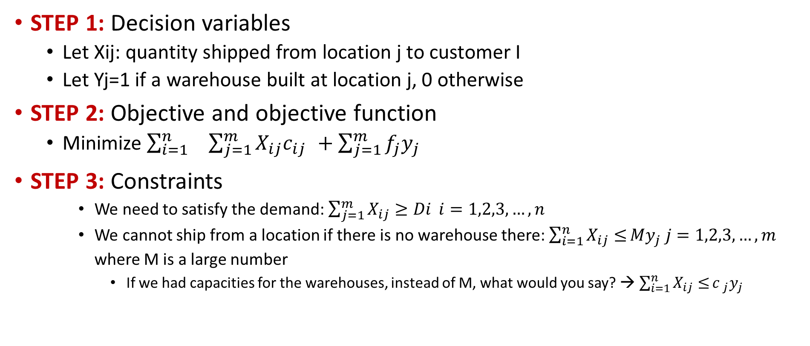
Integrated Facility Location-Transportation
STEP 1: Decision variables
  Let Xij: quantity shipped from location j to customer I
  Let Yj=1 if a warehouse built at location j, 0 otherwise
STEP 2: Objective and objective function
  Minimize $\sum_{i=1}^{n}{ } _{ }\sum_{j=1}^{m}{{X_{ij}c}_{ij _{ }}+\sum_{j=1}^{m}{f_{j}{y_{j}}_{ }}}$
STEP 3: Constraints
    We need to satisfy the demand: $\sum_{j=1}^{m}{X_{ij}≥Di} i=1,2,3,…,n$
    We cannot ship from a location if there is no warehouse there: $\sum_{i=1}^{n}{X_{ij}≤}{My}_{j} j=1,2,3,…,m$
    where M is a large number
      If we had capacities for the warehouses, instead of M, what would you say? → $\sum_{i=1}^{n}{X_{ij}≤}{c _{j}y}_{j}$

Slide 86
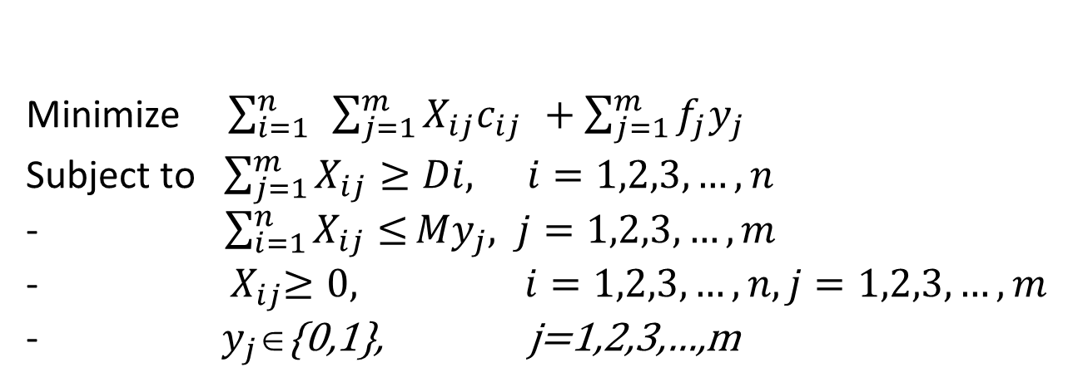
Mixed-Integer Programming
Combining everything
This is a mixed-integer-linear-programming (MILP) problem
      You have continuous variables Xij
      You have binary variables yj
      Everything is linear
    Minimize $\sum_{i=1}^{n}{ }\sum_{j=1}^{m}{{X_{ij}c}_{ij _{ }}+\sum_{j=1}^{m}{f_{j}{y_{j}}_{ }}}$
    Subject to $\sum_{j=1}^{m}{X_{ij}≥Di,} i=1,2,3,…,n$
    - $\sum_{i=1}^{n}{X_{ij}≤}{My}_{j}, j=1,2,3,…,m$
    ${ X}_{ij}≥0, i=1,2,3,…,n,j=1,2,3,…,m$
    $y_{j}\text{∈}${0,1}, j=1,2,3,…,m

